Slide 1
Aromatic compounds
Dr.Entssar Alshaway

Slide 2
Friedel–Crafts Alkylation:
Synthesis of alkyl benzenes from alkyl halides and a Lewis acid, usually AlCl₃.
Reactions of alkyl halide with Lewis acid produces a carbocation, which is the electrophile.

Slide 3
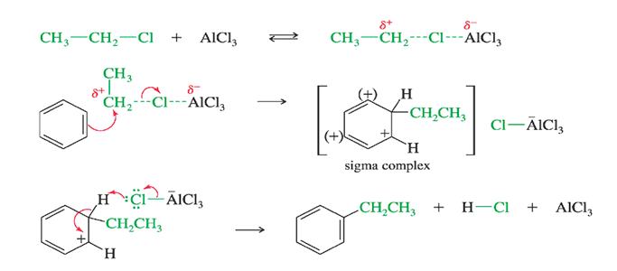
Mechanism :

Slide 4
Friedel–Crafts Acylation:
Acyl chloride is used in place of alkyl chloride.
The product is a phenyl ketone that is less reactive than benzene.
Mechanism of Acylation
Step 1: Formation of the acylium ion.
Step 2: Electrophilic attack to form the sigma complex.
Step3:deprotenation of sigma complex

Slide 5
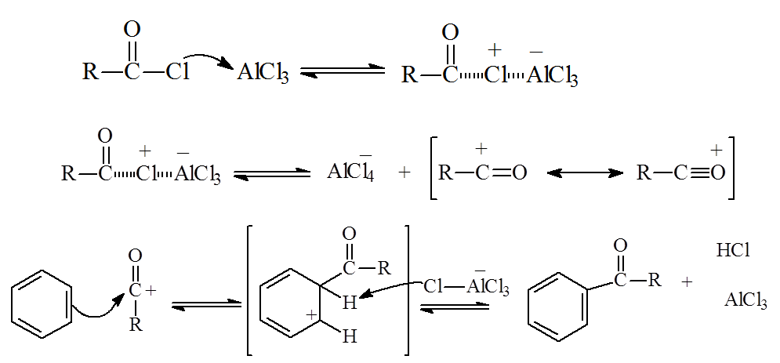
Mechanism of Acylation

Slide 6
Clemmensen Reduction
Acyl benzenes can be converted to alkyl benzenes by treatment with aqueous HCl and amalgamated zinc.

Slide 7
Side-Chain Halogenation
Benzylic position is the most reactive.
Chlorination is not as selective as bromination, results in mixtures.Br₂ reacts only at the benzylic position.

Slide 8
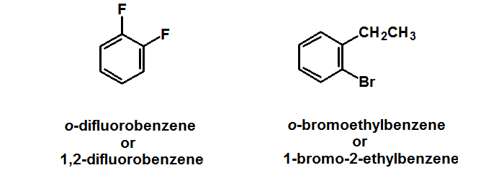
Disubstituted Benzenes
1-ortho (abbreviated o- )= 1,2-disubstituted (two groups on adjacent carbons on the ring)

Slide 9
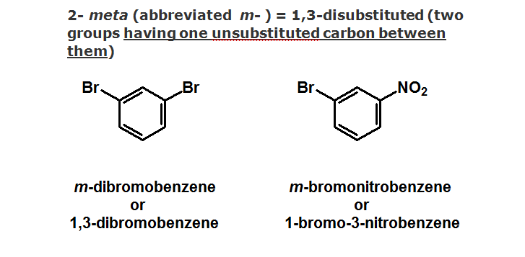

Slide 10
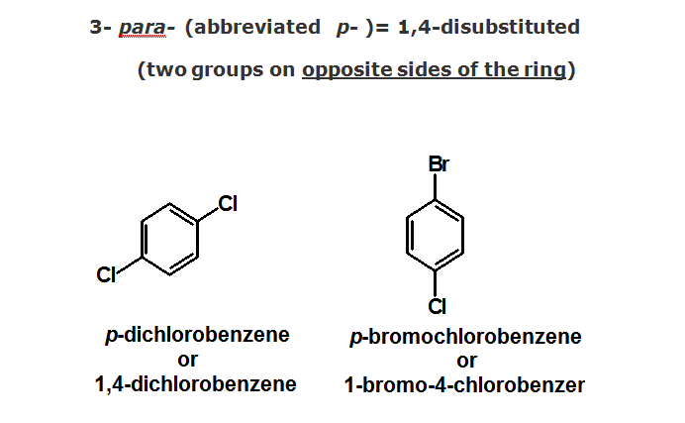

Slide 11
Substituent groups on a benzene ring affect electrophilic aromatic substitution
reactions in two ways:
1-reactivity
activate (faster than benzene)
or deactivate (slower than benzene)
2-orientation
ortho- + para- direction
or meta- direction

Slide 12
CH₃
activates the benzene ring towards EAS
directs substitution to the ortho- & para- positions
-NO₂
deactivates the benzene ring towards EAS
directs substitution to the meta- position

Slide 14
Electron donating groups activate the benzene ring to electrophilic aromatic substitution.
1-electron donating groups increase the electron density in the ring and make it more reactive with electrophiles.
2-electron donation stabilizes the intermediate carbocation, and increases the rate.

Slide 15
Electron withdrawing groups deactivate the benzene ring to electrophilic aromatic substitution.
1-electron withdrawing groups decrease the electron density in the ring and make it less reactive with electrophiles.
2-electron withdrawal destabilizes the intermediate carbocation, and slowing the rate.

Slide 16
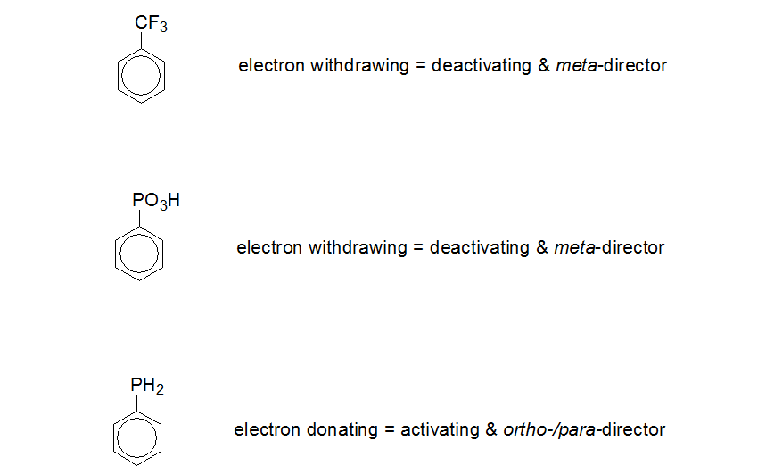

Slide 17
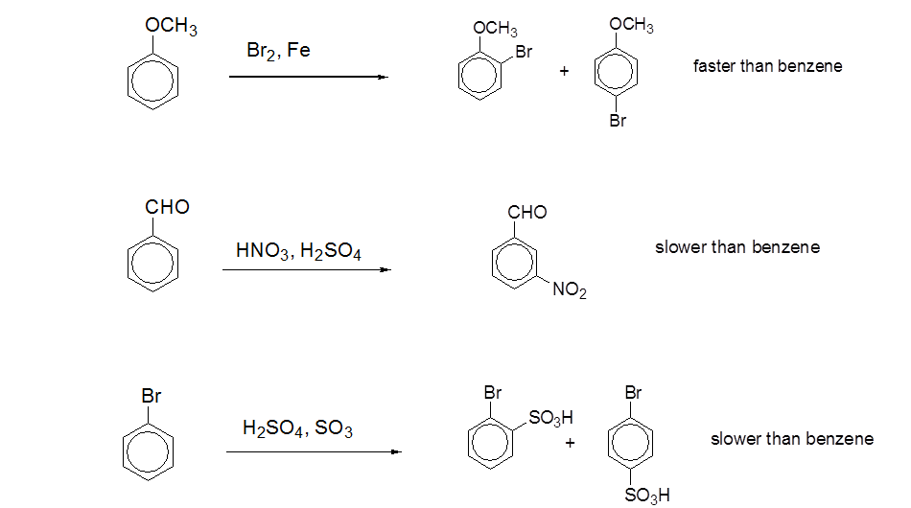

Slide 18
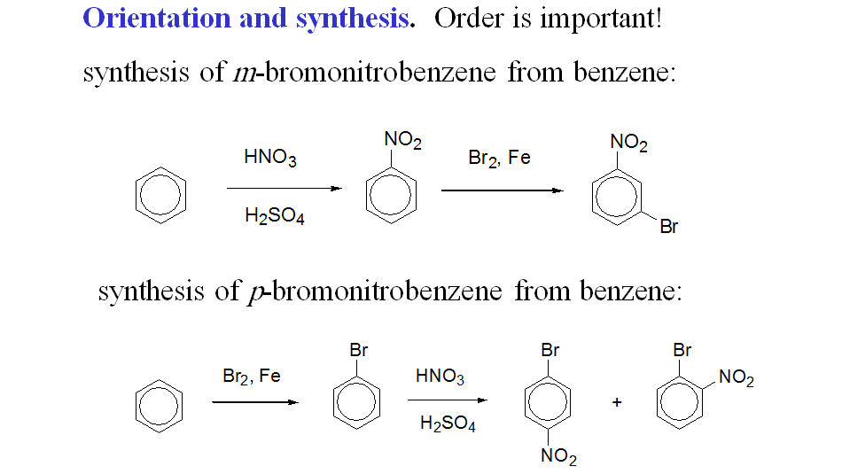

Slide 19
